Slide 1
DevOps: An IT Pro Guide
David Tesar @dtzar
Morgan Webb @morgan_msft

Slide 2
Course Topics
DevOps: An IT Pro Guide
01 | Introduction & Planning | 04 | Operate
02 | Develop | 05 | Closing
03 | Release

Slide 3
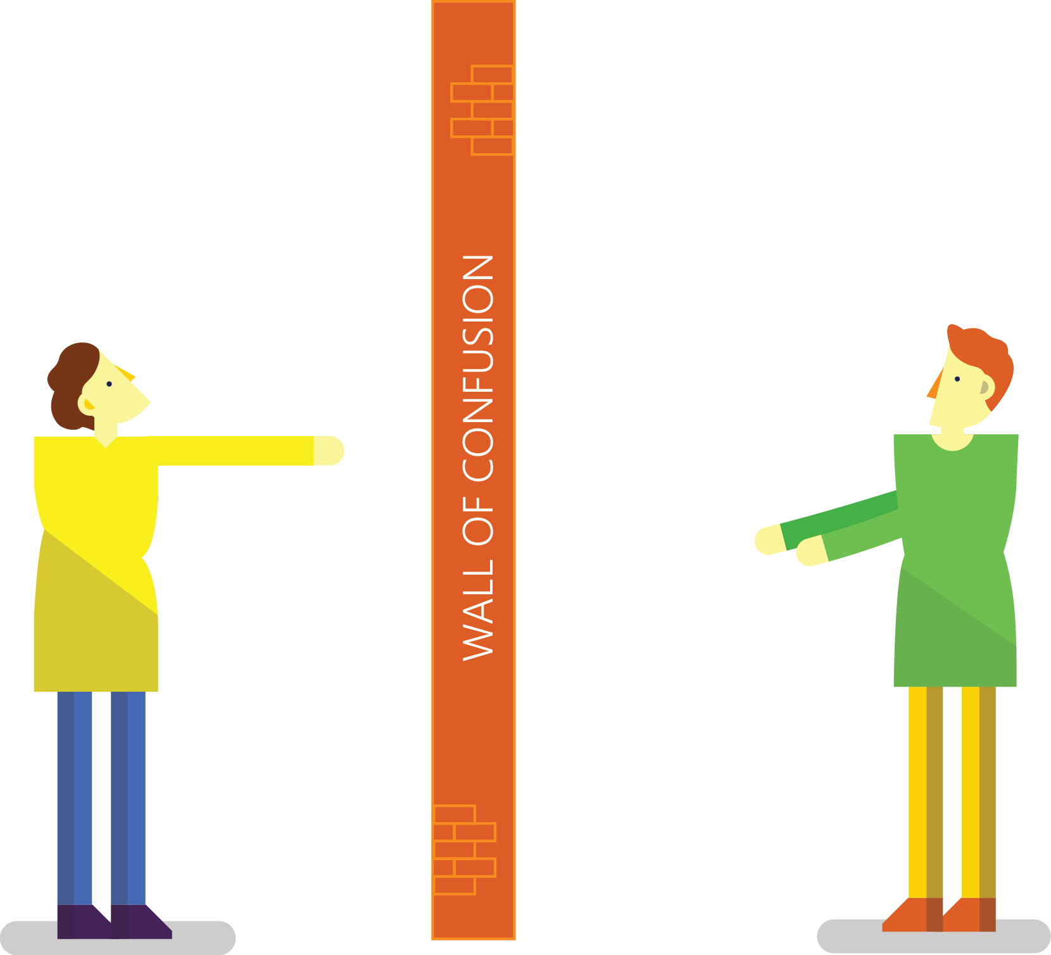

Traditional Development and Operations
DEV
OPS
Notes:
Taken from: http://dev2ops.org/2010/02/what-is-devops/
Development kicks things off by “tossing” a software release “over the wall” to Operations. Operations picks up the release artifacts and begins preparing for their deployment. Operations manually hacks the deployment scripts provided by the developers or creates their own scripts. They also hand edit configuration files to reflect the production environment, which is significantly different than the Development or QA environments. At best they are duplicating work that was already done in previous environments, at worst they are about to introduce or uncover new bugs.
Operations then embarks on what they understand to be the currently correct deployment process, which at this point is essentially being performed for the first time due to the script, configuration, process, and environment differences between Development and Operations. Of course, somewhere along the way a problem occurs and the developers are called in to help troubleshoot. Operations claims that Development gave them faulty artifacts. Developers respond by pointing out that it worked just fine in their environments, so it must be the case that Operations did something wrong. Developers are having a difficult time even diagnosing the problem because the configuration, file locations, and procedure used to get into this state is different then what they expect (if security policies even allow them to access the production servers!).
Time is running out on the change window and, of course, there isn’t a reliable way to roll the environment back to a previously known good state. So what should have been an eventless deployment ended up being an all-hands-on-deck fire drill where a lot of trial and error finally hacked the production environment into a usable state.

Slide 4
People/Process is what % of downtime?
PROCESS
OPERATIONS
APPLICATION FAILURE
OPERATOR ERROR
Change management
Overloaded
Weak problem detection
Forget something
Lack of procedures
Backup errors/security
40%
40%
OTHER
20%
Hardware/OS
Network
Power and disaster
Gartner Security Conference presentation "Operation Zero Downtime," D. Scott
Notes:
Organizations must recognize that people, process, and technology are all interdependent facets of all IT services.
As noted by Gartner above, 80% of operational problems can often be attributed to people and process issues. Only a portion of the remaining 20% is actually technology related – some being external disasters.

Slide 5

What some developers do
I’m running our company application on some machines under my desk and I hope no one notices.

Slide 6



Resolving issues without DevOps
There is no problem with my code, you’re either deploying wrong or there is a problem with your infrastructure.
Infrastructure looks good, must be a code problem.
Customer finds problem with your application.
Operations gets notified of application problem.
DEV
OPS
Notes:
Pager image: http://www.medicoland.eu/ru/pager&page=4

Slide 7

Conflicts across Dev, Ops, and Business
Ops: “You’re losing us money with all these outages!”
Dev: “I need 5 more features on the application by next week.”
You’re causing me outages with all your frequent updates to production… behind my back!
I’m just trying to crank out the code quickly to keep the boss happy. You’re only slowing me down!
BUSINESS
OPS
DEV
Notes:
Dev: “What’s the point of an Agile development process, that produces production ready code every two weeks, if the code sits for weeks or months waiting to be released?”
IT/Ops: “These frequent releases are killing my team, and impacting our ability to have a stable environment!”

Slide 8

What some businesses do
NEW “DEVOPS” GUY

Slide 9

“DevOps is development and operations collaboration”
“DevOps is treating your infrastructure as code”
It’s DevOps!
It’s DevOps!
“DevOps is using automation”
It’s DevOps!
“DevOps is feature switches”
It’s DevOps!
“DevOps is small deployments”
“Kanban for Ops?”

Slide 10


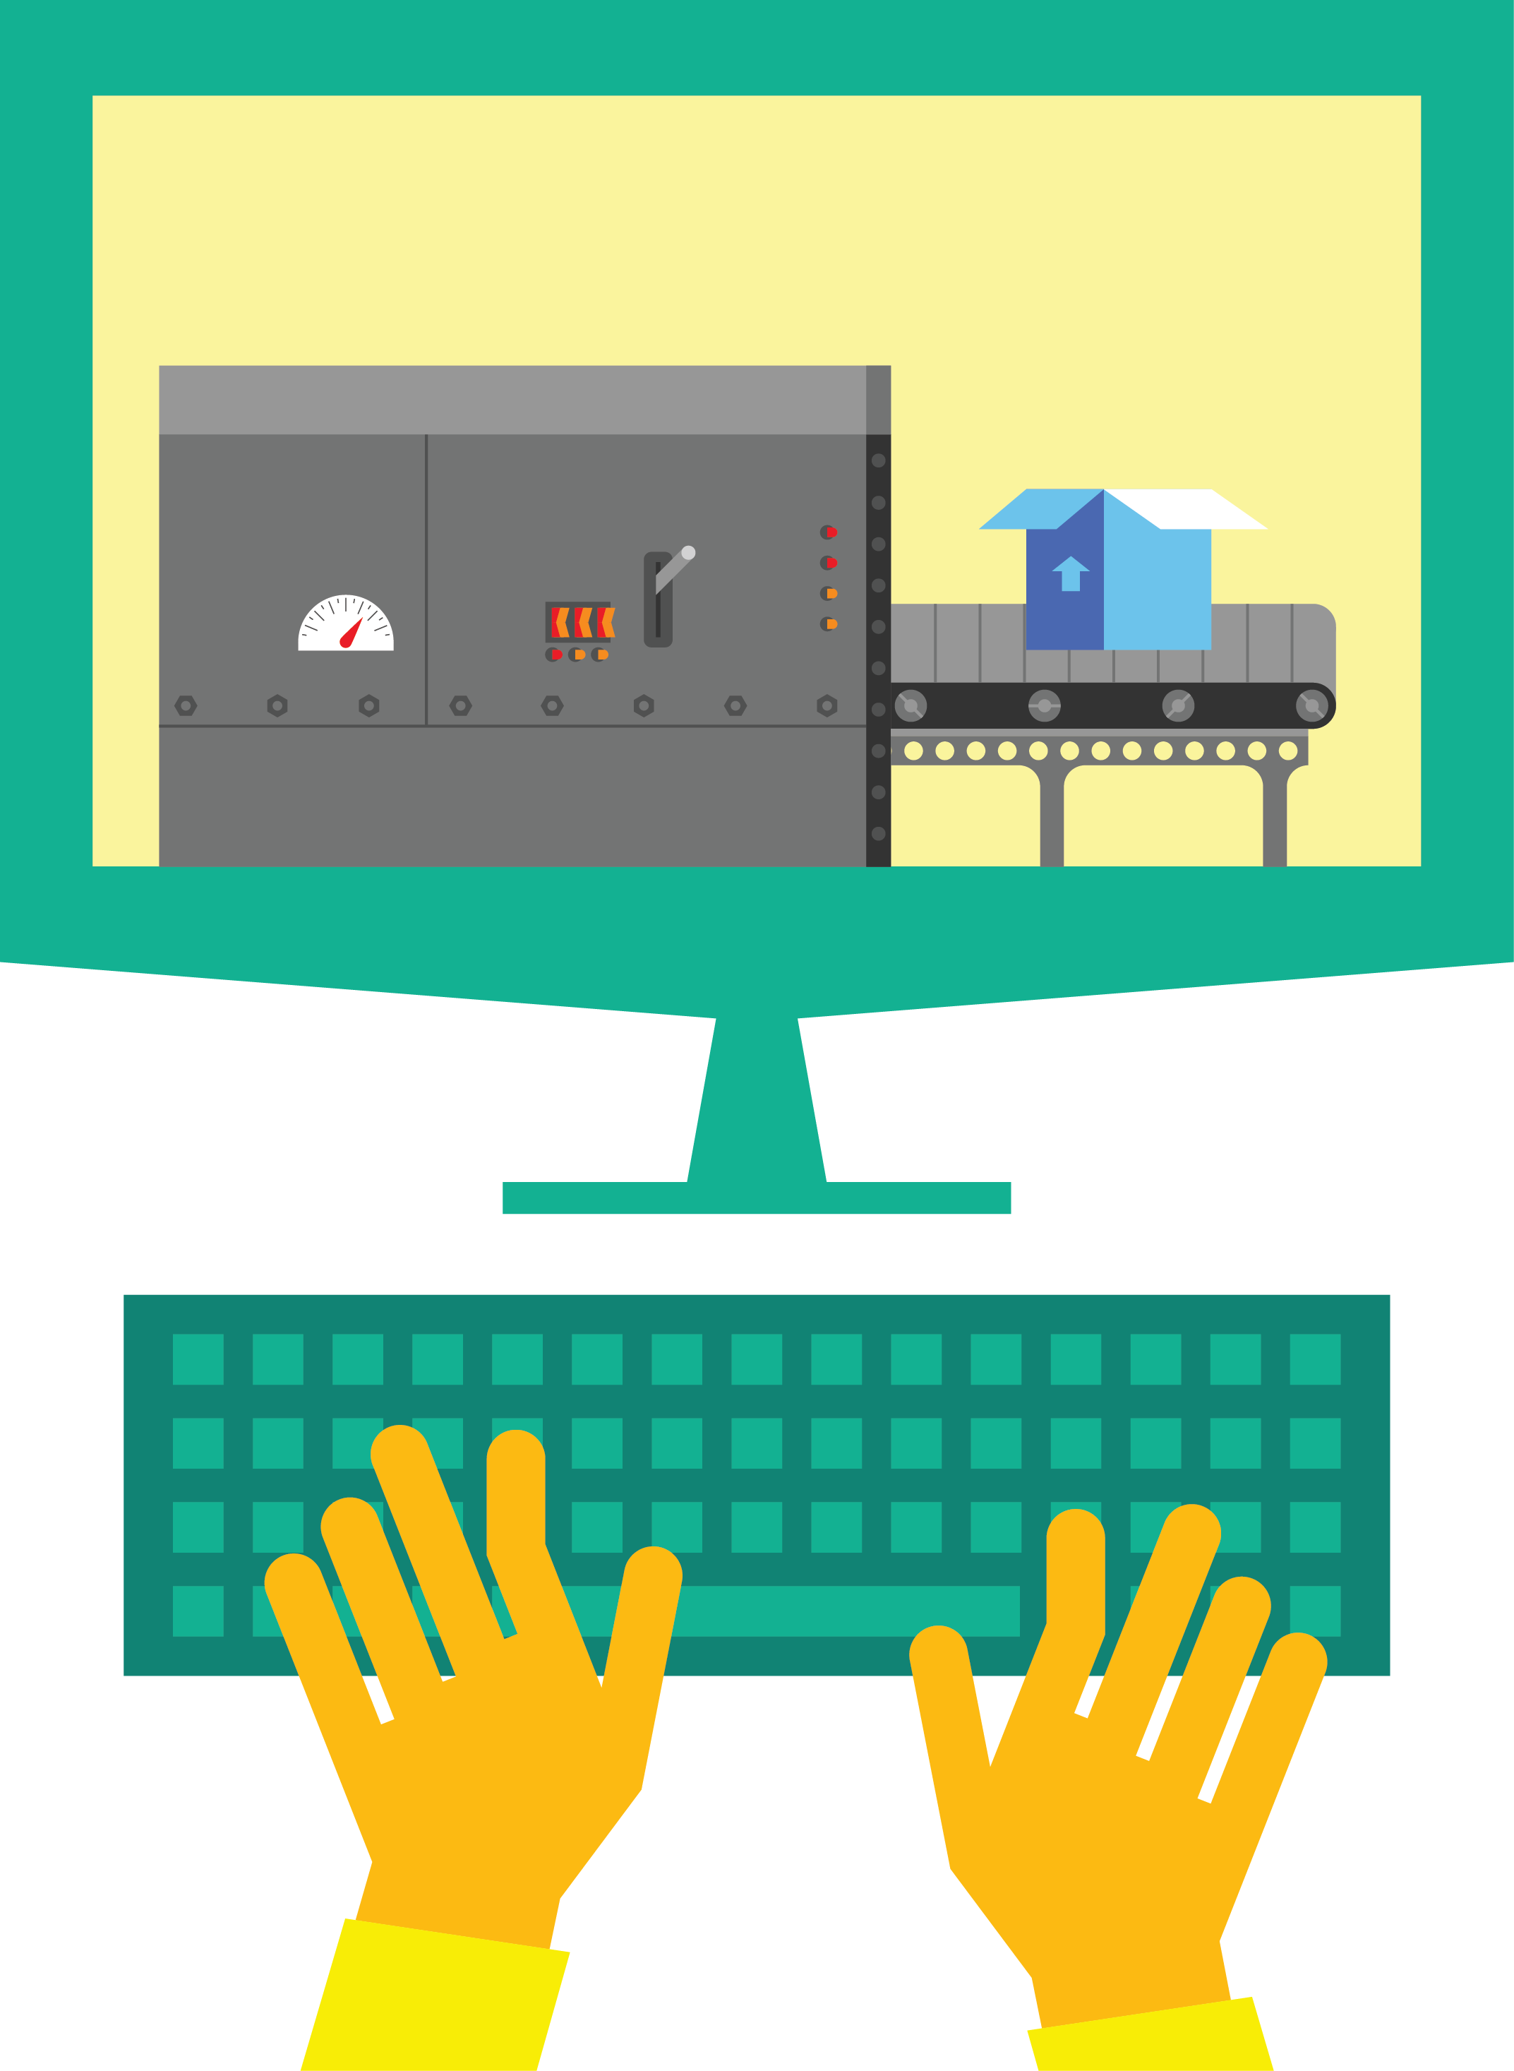

DevOps: the three stage conversation
1
People
2
Process
3
Products
Notes:
People = Culture
Fundamental attributes of successful cultures:
Shared mission and incentives: infrastructure as code, apps as services, DevOps/all as teams
You need to consider your hardware as a commodity, (don't give your servers names) , servers are like farm animals, it is just harder if you let theids name them
Build deep instrumentation into services, push complexity up the stack
Rally around agile, shared metrics, CI, service owners on call, etc.
Changing the culture: any change takes time, changing culture is no exception and you can't do it alone, exploit compelling events to change culture: downtimes, cloud adoption, devops buzz
PROCESS Definition and design, compliance, and continuous improvement
PEOPLE Responsibilities, management, skills development, and discipline
Products Tools and infrastructure

Slide 11
The three ways
DEV
OPS
(Business)
(Customer)
THE FIRST WAY
Flow/systems thinking
THE SECOND WAY
Feedback/amplify feedback loops
THE THIRD WAY
Continual experimentation and learning
Notes:
http://itrevolution.com/a-personal-reinterpretation-of-the-three-ways/
1st - IT places Dev as the business representative and Ops as the customer representative, with the value flowing in one direction (from the business to the customer). When we can think as a system we can focus clearly on the business value that flows between our Business, Dev, Ops and the end users. We can see each piece as it fits into the whole, and can identify its constraints. We can also properly define our work and when we can see and think in terms of the Flow of our system, we see the following benefits:
increased value flow due to the visibility into what it takes to produce our end product
our downstream step always gets what they need, how they need it, when they need it
faster time to market
we bring Ops in earlier in the development process, letting them plan appropriately for the changes that Dev will be making (because we know that all changes can affect how our product is delivered) which leads to less unplanned work or rushed changes
because work is visible, Ops can see the work coming and better prepare
We can identify and address constraints or bottleneck points in our system
2nd Way - It adds a backward facing channel of communications between OPs and Dev. It enforces the idea that to better the product, we always need to communicate. Dev continually improves as an organization when it better sees the outcomes of it’s work. This can be small (inviting the other Tribes to our stand ups) or it can be larger (Including Dev in the on-call rotation, tools development, architecture planning and/or incident management process) But to truly increase our Flow and improve the business value being delivered to the customer our Tribes need to know ‘what happens’, ‘when it happens’. When we increase our Feedback and create a stable Feedback loop we see the following benefits:
Tribal knowledge grows, and we foster a community of sharing
With sharing comes trust and with trust comes greater levels of collaboration. This collaboration will lead to more stability and better Flow
We better understand all of our customers (Ops as a customer, Dev as a Business, but especially our end users, to whom we deliver value.)
We fix our defects faster, and are more aware of what is needed to make sure that type of problem doesn’t happen again
We adapt our processes as we learn more about the inner workings or our other Tribes
We increase our delivery speeds and decrease unplanned work
3rd Way: When we have achieved the first Two Ways we can feel comfortable knowing that we can push the boundaries. We can experiment, and fail fast, or achieve greatness. We have a constant feedback loop for each small experiment that allows us to validate our theories quickly.
we fail often and sometimes intentionally to learn how to respond properly and where our limits are
we inject faults into the production system and early as possible in the delivery pipeline
we practice for outages and find innovative ways to deal with them
we push ourselves into the unknown more frequently and become comfortable in the uncomfortable
we innovate and iterate in a ‘controlled’ manner, knowing when should keep pushing and when we should stop
our code commits are more reliable, and production ready
we test our business hypotheses (at the beginning of the product pipeline), and measure the business results
we constantly put pressure into the system, striving to decrease cycle times and improve flow

Slide 12

ITIL and DevOps
PROCESS
SERVICE DELIVERY PROCESSES
SERVICE DELIVERY PROCESSES
Service Continuity Management Availability Management
Service Continuity Management Availability Management
Service Level Management
Service Level Management
Financial Management
Capacity Management
Financial Management
Capacity Management
CONTROL PROCESSES
CONTROL PROCESSES
Configuration Management
Change Management
Configuration Management
Change Management
RESOLUTION PROCESSES
RELATIONSHIP PROCESSES
RESOLUTION PROCESSES
RELATIONSHIP PROCESSES
RELEASE PROCESS
Business Relationship Management
Supplier Management
RELEASE PROCESS
Business Relationship Management
Supplier Management
Incident Management
Problem Management
Knowledge Management
Incident Management
Problem Management
Knowledge Management
Release Management
Release Management
Notes:
Resources:
http://en.wikipedia.org/wiki/Information_Technology_Infrastructure_Library
“The Information Technology Infrastructure Library (ITIL) is a set of practices for IT service management (ITSM) that focuses on aligning IT services with the needs of business.”
http://www.itil-officialsite.com/
Books: The Visible Ops – Gene Kim & The DevOps Cookbook - http://itrevolution.com/books/
MVA courses:
http://www.microsoftvirtualacademy.com/training-courses/it-service-management-with-system-center-2012-r2
http://www.microsoftvirtualacademy.com/training-courses/system-center-2012-service-manager-planning-deploying-managing
http://www.microsoftvirtualacademy.com/training-courses/system-center-2012-r2-itil-for-it-pros

Slide 13


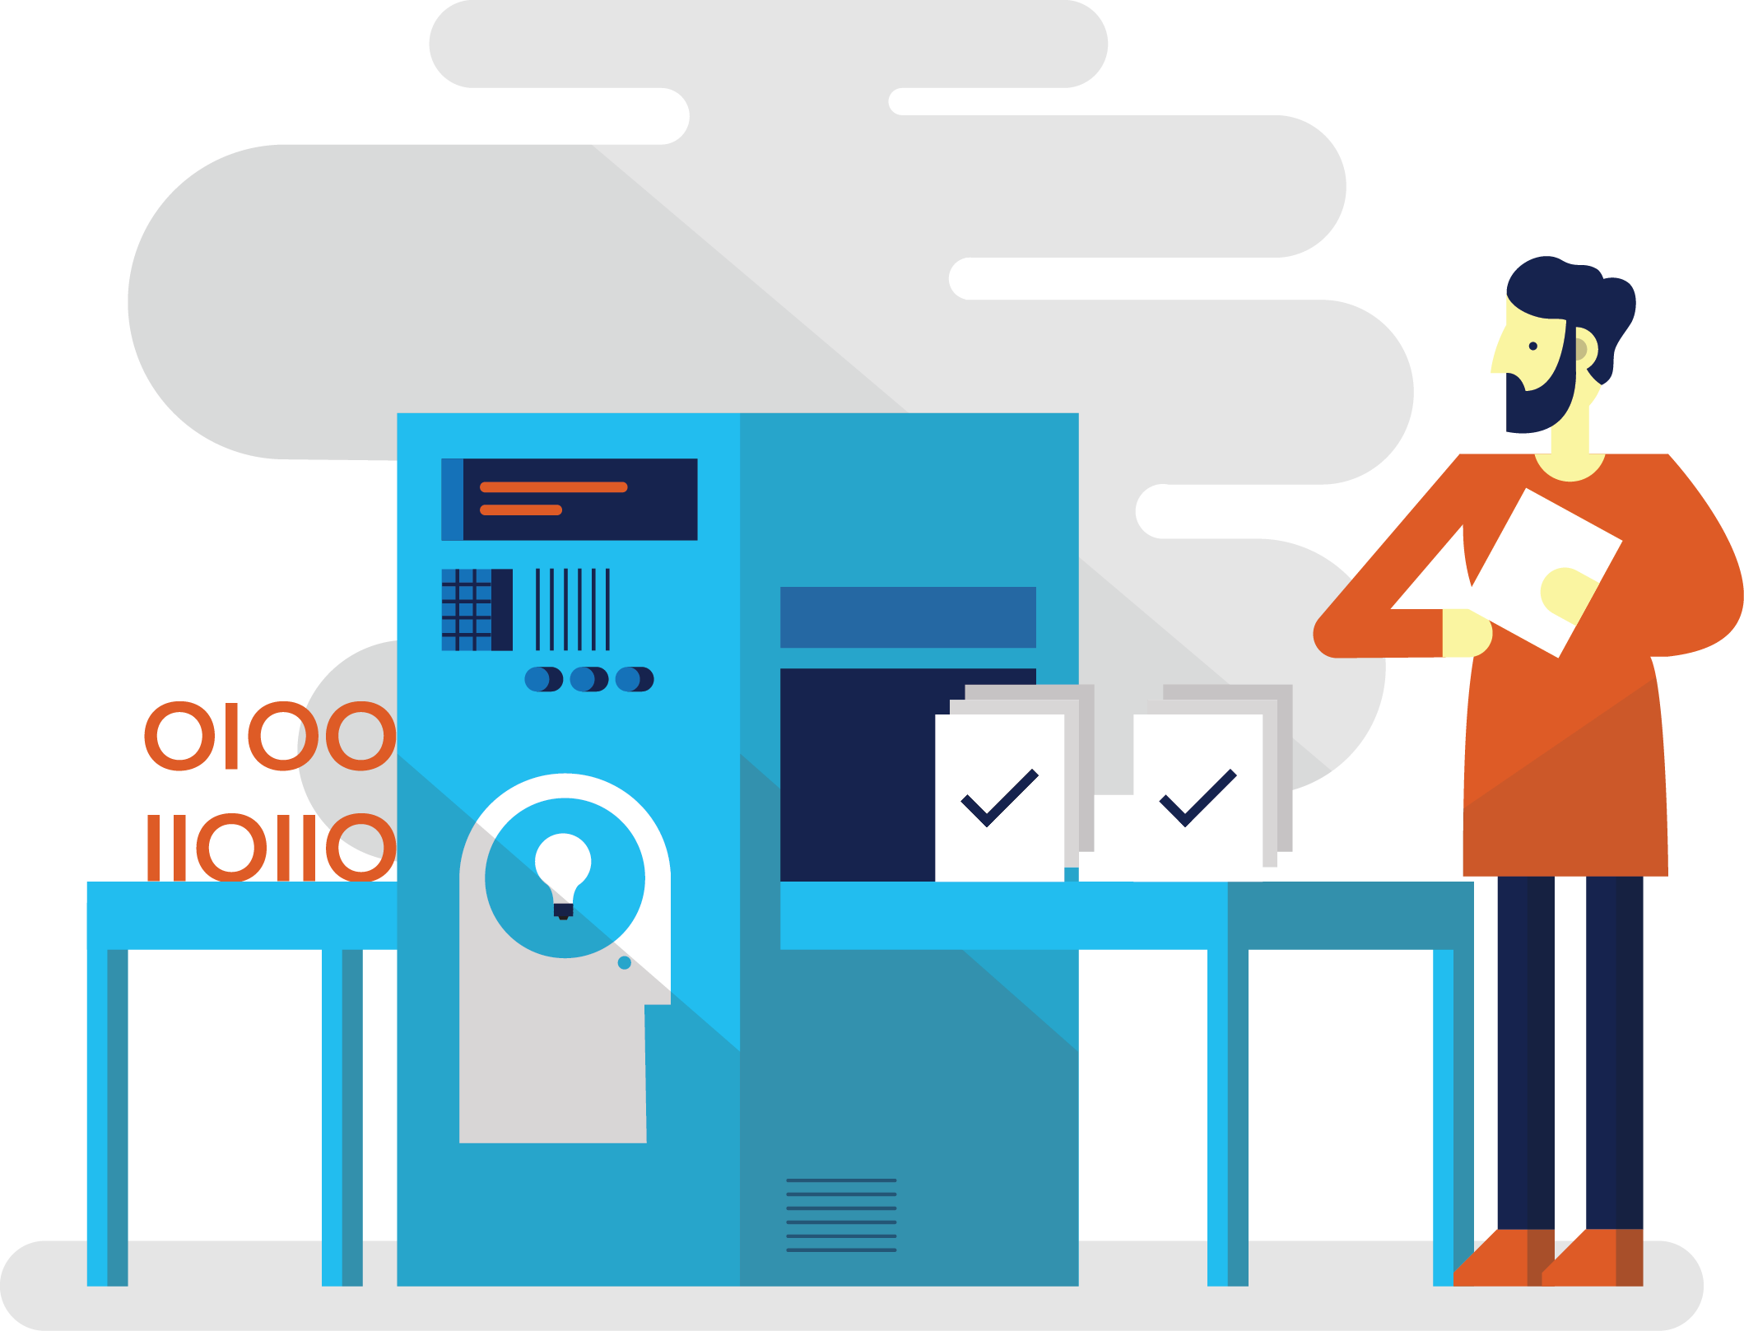

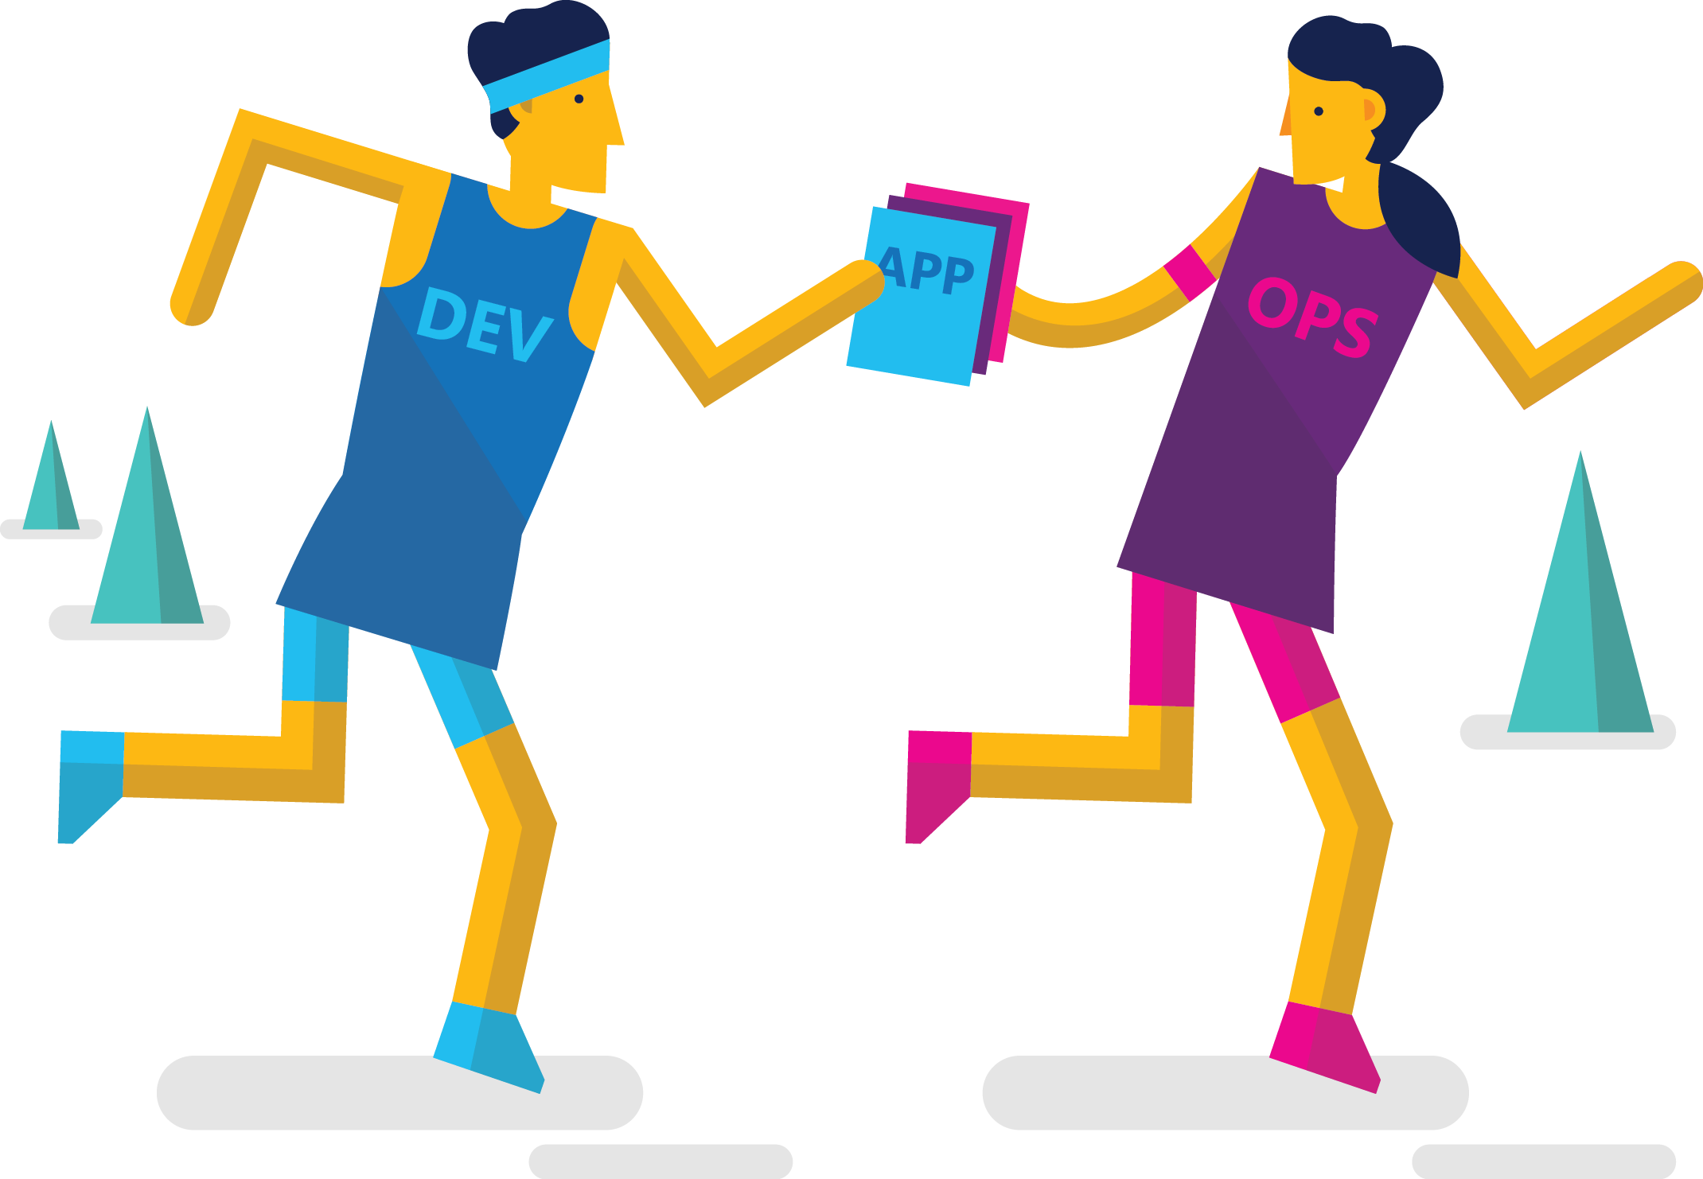
How can Operations help with DevOps?
3
Improve availability
4
Accelerate delivery
Increase application quality
1
2
Optimize resources
SLA
Do these…

Slide 14
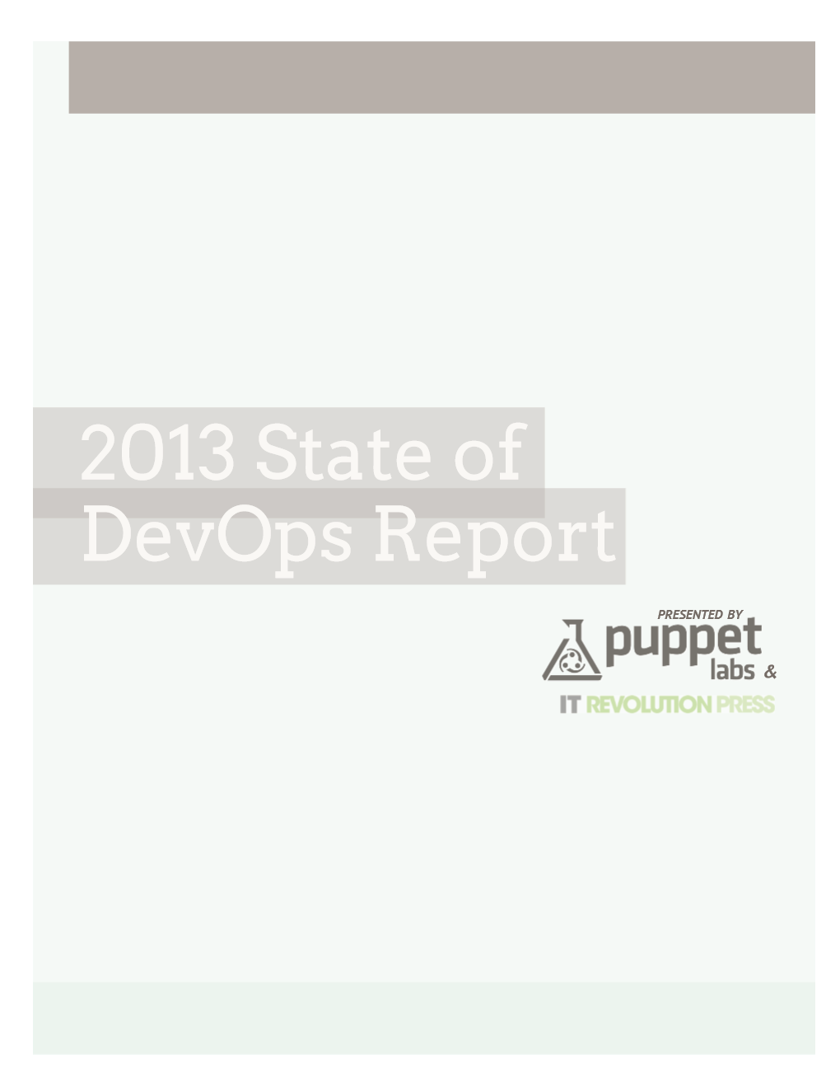
DevOps benefits
Key findings:
Organizations that implemented DevOps reported:
ORGANIZATIONS THAT HAVE IMPLEMENTED DEVOPS SAW THESE BENEFITS:
Improved quality of software deployments
High performance and reliability
IMPROVED QUALITY OF SOFTWARE DEPLOYMENTS
65%
MORE FREQUENT SOFTWARE RELEASES
63%
TOP 5 TOOLS USED TO SUPPORT DEVOPS INITIATIVES
IMPROVED VISIBILITY INTO IT
PROCESS AND REQUIREMENTS
61%
VERSION CONTROL SYSTEMS
84%
CULTURAL CHANGE
COLLABORATION/COOPERATION
55%
CONFIGURATION MANAGEMENT
78%
MORE RESPONSIVENESS TO BUSINESS NEEDS
55%
Source: https://puppetlabs.com/
MORE AGILE DEVELOPMENT
51%
TICKETING SYSTEM
68%
Ship code 30x faster
and complete those deployments 8,000 times faster than their peers.
Have 50% fewer failures
and restore service 12 times faster than their peers.
MORE AGILE CHANGE MANAGEMENT PROCESS
45%
RESOURCE MONITORING
60%
PROVISIONING
56%
IMPROVED QUALITY OF CODE
38%

Slide 15
Foundational DevOps terms
PROCESS
MTTD – Mean time to detection
MTTF – Mean time to failure
MTBF – Mean time between failures
MTTR – Mean time to resolution
Continuous Delivery
Automated testing, Continuous integration, Continuous deployment
Notes:
This is your output to measure

Slide 16
Some essential Qs for Ops in Plan phase
When does application development start?
Where is this app going to live eventually?
Any sensitive information?
What infrastructure is required through the phases?
What kind of SLA & performance does business eventually desire?
How much will it cost to run the infrastructure?
START TO BE INVOLVED

Slide 17
Gartner view of ALM
OPERATE
ANALYZE
MONITOR
DEPLOY
OPS
CODE
BUILD
UNIT TEST
INTEGRATION TEST
LOAD TEST
ASSESS
DESIGN
RELEASE
PLAN
CODE
BUILD
UNIT TEST
REGRESSION TEST
FUNCTION TEST
DEVELOP + TEST
RELEASE
TEST
DEV
CODE
BUILD
UNIT TEST

Slide 18

Microsoft’s ALM framework
Plan
Operate + learn
Requirements
Development
Collaboration
Production
Develop + test
Release
Notes:
Modern application lifecycle management practices enable teams to support a continuous delivery cadence that balances agility and quality, while removing the traditional silos separating developers from operations and business stakeholders. This improves communication and collaboration within development teams, and drives connections between application and business outcomes. We see three key metrics that are critical to an organization’s ability to enable value delivery with agility and quality. First, the flow of business value must be measured and improved. Understanding what provides business value, and delivering those features on a sustained, regular cadence is key. The second is having the ability to identify and remove bottlenecks to shorten cycle times for delivering those business values. It’s not enough to simply deliver regularly, but also efficiently. And finally, identify and reduce sources of rework, such as bugs, incorrectly specified features, etc.

Slide 19
ALM framework
Source
Build
Deployment
Application
Operations
Cloud
Test/issues
On-premises
Process tools

Slide 20
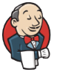

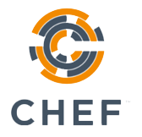
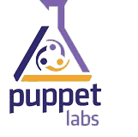







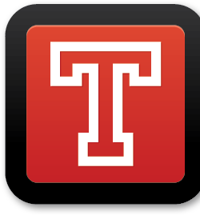


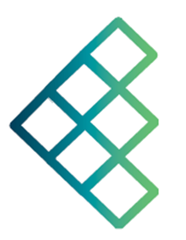
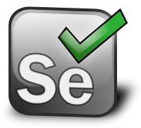



Open source ecosystem
Source
Build
Deploy
App
Ops
GitHub
Codeplex
Chef
Puppet Labs
Public Cloud
Jenkins
Hudson
Microsoft Azure
Alerting
Configuration
Grunt
Gradle
Jenkins
Hudson
Linux
Zabbix
Cacti
On-premises
Monitor
Test/issues
Gradle
Vagrant
Travis
Fog
Grunt
Visual Studio
Puppet Labs
Eclipse
Selenium
Process tools
Redmine
JIRA
Notes:
http://www.redmine.org/
https://www.atlassian.com/software/jira/

Slide 21
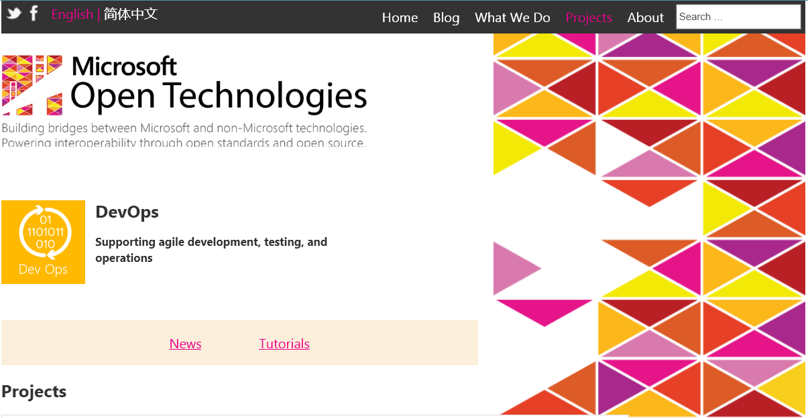
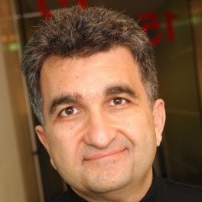




MSOpenTech & DevOps
Interoperability through open source and open standards
Wholly owned subsidiary of Microsoft
Independent cadence enables a closer interaction with open source partners
Team of high skilled executives
http://msopentech.com/blog/project-categories/devops/
Notes:
Timing: 2 minutes
To further advance the company’s long-standing investments in openness including interoperability, open standards and open source, Microsoft launched a wholly-owned subsidiary Microsoft Open Technologies, Inc. (MS Open Tech) in early 2012.
We are motivated by the core belief that open technology is a powerful enabler – and this concept underscores all of the work we do to create technical bridges between Microsoft and non-Microsoft technologies.
We are an organization of engineers, standards professionals and technical evangelists who are both experienced in and passionate about working with an equally diverse set of technologies. In addition, we leverage our ability to marshal engineering talent from Microsoft on a project basis through the MS Open Tech Hub engineering program to help facilitate the exchange and evolution of open source engineering best practices.
Code talks within MS Open Tech. Many of our primary activities encompass building open source code and promoting the development and adoption of open technical standards specifications to deliver a more seamless experience across hardware, software and devices. Please visit our Projects page for more details about our community contributions in these areas
Main Executives
MS Open Tech Executives
Jean Paoli
President
In his role as President of MS Open Tech, Jean leads a diverse team of engineers, standards professionals and technical evangelists to promote open platform development and customer choice by delivering new technologies in collaboration with open source and standards communities.
A passionate advocate of open standards since 1985, Jean was one of the co-creators of the XML 1.0 standard via the World Wide Web Consortium (W3C), and he has garnered multiple industry awards for his work.
Upon joining Microsoft Corporation in 1996, Jean jump-started XML development and managed the team that delivered msxml, the software that XML-enabled both Internet Explorer and the Windows operating system. Jean helped architect Office XML support and was instrumental in creating InfoPath, the XML Office Electronic Forms application. He also participated in ISO/IEC SC34/ WG4 and as co-chair of the TC45 Ecma standards committee that formalized the Office Open XML Format as an international standard.
Operating as a distinct business operation since 2012, Jean’s team at MS Open Tech has worked closely with many business groups across Microsoft to promote several technical standards, including W3C’s HTML5, IETF’s HTTP 2.0, Cloud standards in DMTF and OASIS. The team also collaborates with a broad variety of development communities to contribute tools that promote interoperability between Microsoft technologies within open source environments such as Node.js, MongoDB and Phonegap.
Prior to Microsoft, Jean worked with a number of European research institutes, including INRIA in France, where he designed systems to facilitate data exchange for major corporations
Gianugo Rabellino
Senior Director of Open Source Communities
With more than 20 years of experience in the open source community, Gianugo brings a deep understanding of open technologies and platforms to his role as Senior Director of Open Source Communities at MS Open Tech. He is charged with promoting the team’s broad engagement with developer communities to help create new business opportunities using Microsoft and non-Microsoft technologies.
Gianugo has also been an active member of the Apache Software Foundation since 1999, where he currently serves as vice president of the Apache XML Project Management Committee. Additionally, he assists on a number of projects as a mentor through the Apache Incubator, and speaks at conferences around the world about open development.
Previously, Gianugo was the founder and CEO of Sourcesense, the leading open source services company in Europe, where he drove sustained double-digit growth to expand its operations across Italy, the Netherlands and the UK.
Gianugo has also held a variety of senior management roles at Pro-netics, Ksolutions, and Bibop Research where he was responsible for the software development and system/network administration groups and worked with several customers including Sun, IBM, Oracle, ISP and the Apache Software Foundation.
As an open source technical and policy consultant, he co-founded the first official Linux association in Italy, elevating Linux and open source development to the mainstream within that region.
He received his undergraduate degree from Liceo Classico Gabriello Chiabrera and his graduate degree from Universita degli Studi di Genova.
Twitter: @Gianugo
Kamaljit Bath
Director of Engineering Team
Kamaljit joined MS Open Tech with nearly 20 years of diverse software industry experience at various levels. He leads the company’s engineering team to create standards-based tools that facilitate interoperability between open source and Microsoft products and technologies, which has resulted in open source project contributions such as: WebKit, Blink, Node.js, Apache QPID, jQuery and Apache Cordova.
Kamaljit also coordinates the Interoperability Executive Customer (IEC) Council – an advisory board comprised of ~35 CIOs representing global public and private sector enterprises. In this capacity, he works closely with many Microsoft product teams, standards and policy teams, as well as the Microsoft Trustworthy Computing and Engineering Excellence teams, to strategize on features, best practices and trainings that align with the objective of achieving greater interoperability with Microsoft products and technologies.
Previously, Kamaljit spearheaded Microsoft’s first-ever participation in an Apache-sponsored open source project, managing the Apache Stonehenge incubator to showcase the interoperability of web services standards. He was also lead program manager on both the Microsoft Office InfoPath and Microsoft SQL Server teams. Prior to Microsoft, he worked as an Oracle database and forms programmer and mainframe to client-server systems analyst in several Fortune 500 companies.
Kamaljit received his Bachelor of Science in Computer Science from National Institute of Technology, Allahabad, India in India.
Paul Cotton
Partner Group Manager
Paul leads the standards team MS Open Tech. He has nearly 40 years of experience in all aspects of software development. He is credited with Microsoft’s cloud computing interoperability and standards strategy and he previously led the company’s multi-year web services standardization efforts within W3C, OASIS and WS-I.
After several leadership roles within the W3C, Paul presently serves as co-chair of the working group responsible for the HTML5 specification. Paul is also a Microsoft Standards Advisor supporting cross-divisional strategic standards issues and acts chair of Canadian Advisory Committees for the International Organization for Standardization (ISO) - SC 38 Cloud Computing and SC 34 Document Description and Processing Languages.
Paul also architected, developed and managed the SQL-based full-text product with an Open DataBase Connectivity (ODBC) interface, and was a major contributor to consortium efforts such as ATA SFQL, SQL Access Group CLI, SQLJ and SQLX.
Prior to Microsoft, Paul founded a consulting company and software vendor, Officesmiths, where he was an architect and development manager for a successful office automation software product. He has served as the United Nations advisor and project manager to successful software projects in Chile and Burma. He has also worked for IBM Canada, Fulcrum Technologies, PBC & Associates, Alphatext Inc., and Statistics Canada.
Paul received his undergraduate degree, and a Masters of Mathematics from the University of Waterloo.

Slide 22


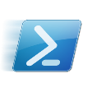

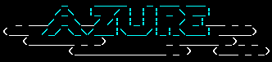

Microsoft ecosystem
Repository
Build
Deploy
App
Ops
Release Management for Visual Studio
Microsoft Azure
Team Foundation Server
Team Foundation Server
ONE CONSISTENT PLATFORM
Visual Studio Online Application Insights
ON-PREMISES
SERVICE PROVIDER
OR
Release Management for Visual Studio
Automation Service
TFVC
GIT
System Center
Operations Manager
Test
PowerShell
WAML
Team Foundation Server
Microsoft Test Manager
Microsoft Monitoring Agent
xPlat CLI
Resource Groups
Process tools
Release Management for Visual Studio
Service Manager

Slide 23

Cloud OS hybrid design
flexible development
unified management
common identity
integrated virtualization
complete data platform
Customer
On premise
Cloud
ONE
Consistent Platform
Service Provider
Microsoft
Notes:
Slide talk track:
This “hybrid design” is the core of Microsoft’s Cloud OS vision
You benefit from a common and consistent approach to development, management, identity, virtualization and data – spanning on-premises to cloud – your cloud, a service provider cloud and Microsoft’s cloud
This is powerful because we will deliver a flexible development environment for the developer so that it can code once and deploy anywhere; deploy on premises, deploy out to a partner cloud, deploy out to Azure cloud. But they only have to write the app once on the power of our .NET framework.
Unified management is our ability to use System Center, sitting in your datacenter to administer all the automation scripts to manage and pool the resources of that datacenter. Well while you’re looking in that pane of glass, to be able to provision and move VMs, objects, data from your datacenter out through a service provider or out to Azure for bottomless storage, for redundancy, for disaster recovery.
Common identity is a third element of our consistent platform, using Active Directory group policies that you’ve already set up in your enterprise. You merely get the benefit of those group policies extended through Active Directory Federation Services and Azure based Active Directory, so that the group policies you set, extend out to the cloud automatically. You don’t have to manage multiple federation common identity across different clouds.
Integrated virtualization is a fourth area. You no longer have to have a third part bolt on to virtualize your compute. Not only are we giving you compute capability, virtualization of your compute capability imbedded in Windows Server, we’re giving that to you around software defined networking and around virtualization of storage, also.
Lastly, being able to have a complete data platform where your data can reside anywhere across these three clouds in a seamless way is a value proposition that’s huge as well. You can optimize your storage costs in this dimension. All that capability integrated in how we think about the complete data platform for a customer across all clouds.
Our hybrid design gives you the ability, from a one view, to manage apps and data beyond your own private cloud -- to a partner cloud -- to a public cloud -- in a consistent way.
Removes complexity so you can focus on answering those business questions and apps
Helps you be very flexible in thinking about how you deploy your apps across the three clouds

Slide 24
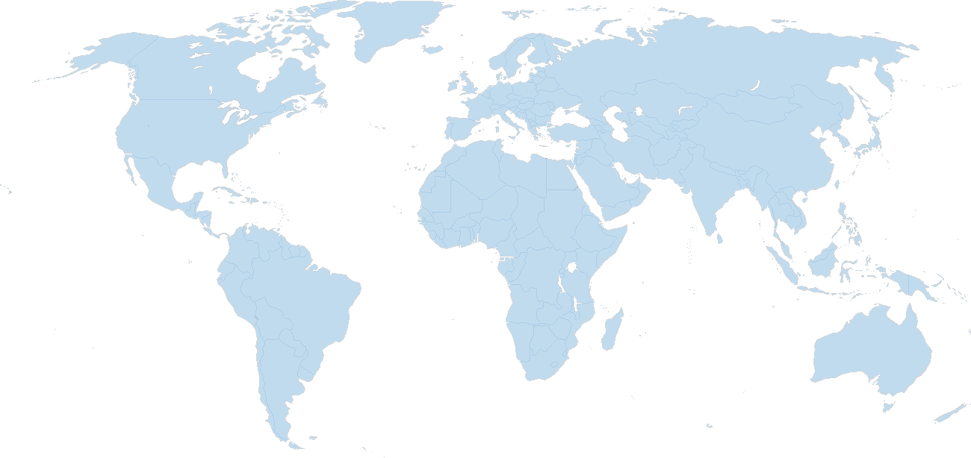
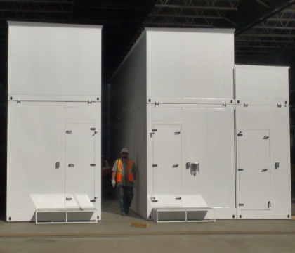

Microsoft Azure DC Presence
North America Region
Europe Region
Asia Pacific Area
N. Central – U.S. Sub-Region
N. Europe
Sub-Region
West – U.S. Sub-Region
East – U.S. Sub-Region
NE. China (via 21Vianet) Sub-Region
East Japan Sub-Region
W. Europe
Sub-Region
West Japan Sub-Region
S. Central – U.S. Sub-Region
E. China (via 21Vianet) Sub-Region
E. Asia Sub-Region
S.E. Asia
Sub-Region
Major datacenter
CDN node
Live sub-region
Announced sub-region
Partner-operated sub-region
LATAM
Sub-Region
East Australia Sub-Region
Southeast Australia Sub-Region
24 x 7 x 365 support 89 markets worldwide 2x Compute and storage every six months

Slide 25



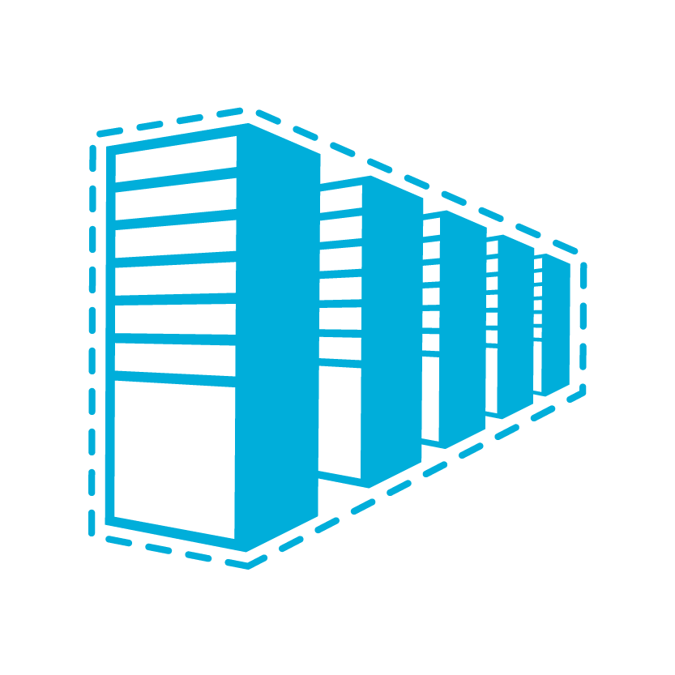










Microsoft Azure
Azure datacenters,
your datacenters.
^{app} ^{services}
cloud services
caching
identity
service bus
media
web sites
integration
hpc
analytics
virtual machines
virtual network
mobile services
vpn
^{data} ^{services}
SQL database
HDInsight
table
blob storage
^{infrastructure} ^{services}
virtual machines
virtual network
vpn
traffic manager
cdn
vpn
Notes:
But that is not all that you can do with Azure. Microsoft Azure also provides infrastructure services which allow for more hands on configuration and management similar the servers you have today. However, they’re hosted in Microsoft datacenters letting you use Azure as if you were operating your own datacenter in the Cloud. For example, you can provision VMs, give them private IP addresses, and connect to them using a VPN from your on-premises environment. Most importantly, this lets Microsoft Azure mimic your on-premises datacenter and run your current apps with little or no change without the expense of having to own servers of racks, cooling and building costs. Furthermore, you can connect the “datacenter” you build in the Cloud to your on-premises datacenter so the datacenter in the Cloud becomes an extension to your on-premises infrastructure.
These “building blocks” lets Microsoft Azure to be used as an Infrastructure-a- a-service.
So, you see Microsoft Azure offers IaaS +PaaS in one platform. IaaS provides flexibility, PaaS eliminates complexity. Use PaaS where you can, use IaaS where you need. With Azure, you can use both together or independently, and build apps of the future. That uniquely differentiates us.

Slide 26
Azure Pack
Customers
Your/Service Provider datacenter
IT Admin
Windows Azure Pack
Admin Portal
Tenant Portal
Resource Clouds
Auto-mation
Billing
Tenant Mgt
Hosting Plans
System Center + Windows Server
Compute, Storage, Network
Notes:
Here’s how: The Windows Azure Pack.
Windows Azure Pack for Windows Server is a collection of Windows Azure technologies, available to Microsoft customers at no additional cost for installation into your data center. It runs on top of Windows Server 2012 R2 and System Center 2012 R2 and, through the use of the Windows Azure technologies, enables you to offer a rich, self-service, multi-tenant cloud, consistent with the public Windows Azure experience.
That’s the long version. Here’s the short one. WAP is a free download that puts Azure in your datacenter.

Slide 27
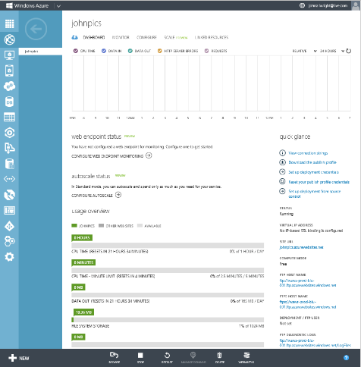
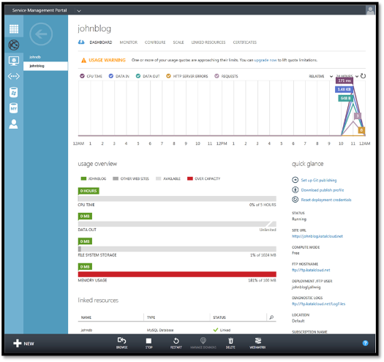
Azure Pack Tenant experience
Dashboard
Customer
ONE
Consistent Platform
Service Provider
Microsoft
Notes:
Once the VM has been provisioned, the Tenant has a rich set of information to help them manage the environment. They can track usage data as well as do some configuration of the VM based on the permissions of the plan to which they subscribed. And, of course, this dashboard easily provides the ability to stop, start and pause the VM as well as connect remotely to it.
(Compare to Azure with image)

Slide 28






Management for the Cloud OS
Source
Build
Deployment
Application
Operations
Deployment
Customer
Operations Manager
App Controller
Orchestrator
ONE
Consistent Platform
Service Provider
Microsoft
Data Protection Manager
Test/issues
Virtual Machine Manager
Service Manager
Configuration
Manager
Process tools
Service Manager

Slide 29
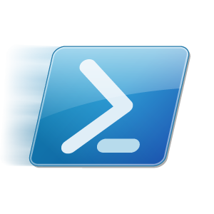
On-premises
Repository
Build
Deploy
App
Ops
Release Management for Visual Studio
Team Foundation
Version Control
Team Foundation
Server
Private Cloud
System Center
Operations Manager
Power Shell DSC
System Center
Virtual Machine Manager
Test
Microsoft Test Manager
Team Foundation Server
Microsoft Monitoring Agent
Process tools
Learn

Slide 30
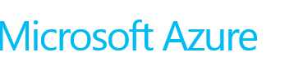
Cloud
Repository
Build
Deploy
App
Ops
IaaS
Visual Studio Online Application Insights
Puppet Labs
PowerShell DSC
IIS VM
SQL VM
PaaS – Cloud Service
Azure Resource Groups
Test
PaaS – Website
Visual Studio Online Application Insights
Microsoft Monitoring Agent
Learn

Slide 31
Key takeaways
Get engaged in the DevOps conversation
Understand Microsoft products related to DevOps
Leverage additional resources to learn more
TechEd NA sessions
Microsoft Virtual Academy courses
Books
Blogs

